Slide 1

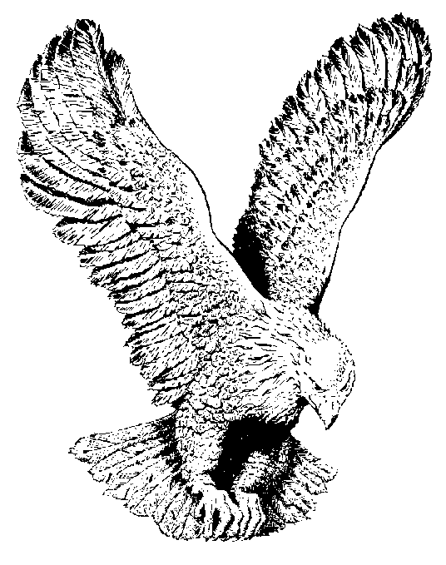
620 IN THE UPPER ROOM
In the upper-room with Jesus,
Sitting at His nail-scarred feet,
Oh, what rich and full communion,
Fellowship divine and sweet.

